Slide 1
Predicting illegal drug usage from personality traits and demographic info
Contributors: Aaron Tan

Slide 2
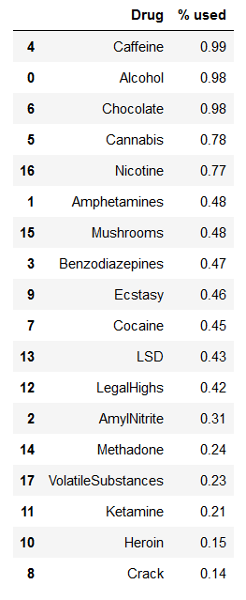
Objective: To determine the demographic factors and personality traits that are predictive of illegal drug usage
Drugs by % of individuals who have used them once or more:
64% of individuals have used one of these illegal drugs at least once
What features are predictive of belonging to this class of individuals?
Data source: Fehrman et al., UCI Machine Learning Repository
Target variable (binary): If an individual has used one of seven illegal drugs (mushrooms, ecstasy, cocaine, LSD, ketamine, heroin, and crack) at least once in their lifetime
Data: 3 demographic factors (gender, age, education), 7 personality traits (Five Factor Model: neuroticism, extraversion, openness to experience, agreeableness, conscientiousness + impulsivity + sensation seeking)

Slide 3
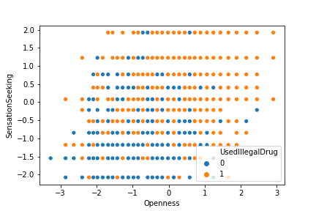
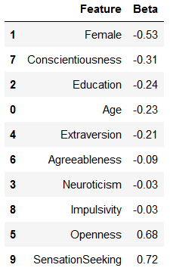
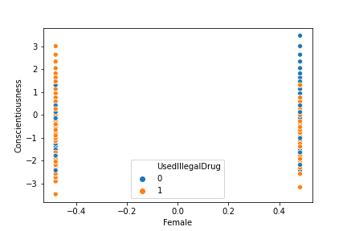
Logistic regression:
20% of data in test set
Default settings = lasso regularization, C = 1, max 100 iterations
Gender (being female) and conscientiousness decrease odds of using an illegal drug, openness and sensation seeking increase odds

Slide 4
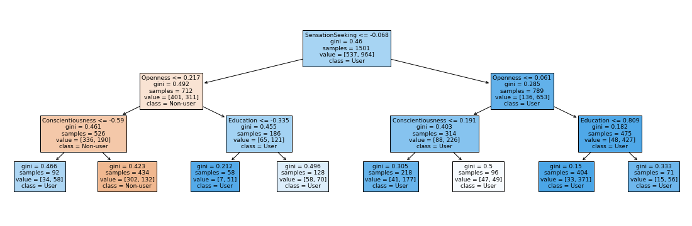
Decision tree classifier
Max depth = 3
Only one leaf ( < sensation seeking, < openness, > conscientiousness) classifies an observation as a user

Slide 5
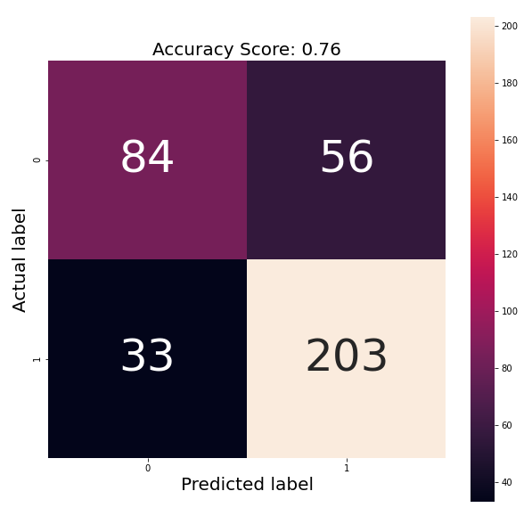
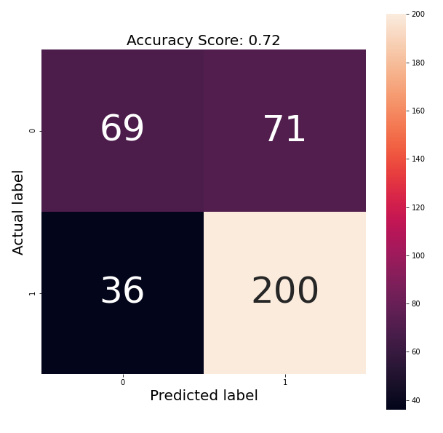
Confusion matrices for logistic regression and decision tree classifier (left, right, respectively)

Slide 6
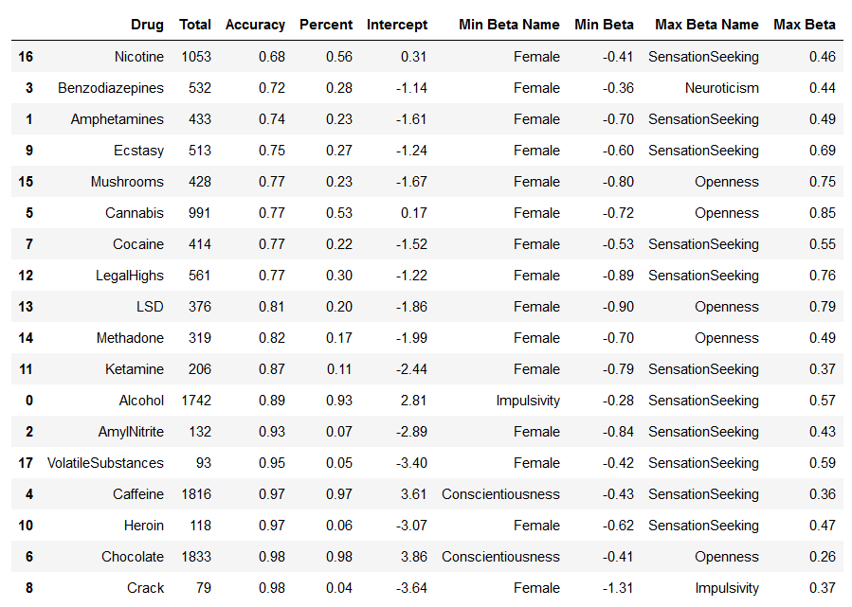
Conclusions and preliminary future directions
Results appear to match published literature (importance of sensation seeking, openness to experience, and gender, ~70% test accuracy) and intuitions
Limitations: Extremely high usage (~15%) of drugs like heroin and crack = not representative, participants disproportionately highly educated and white, no data on life outcomes of participants

